Slide 1


Modelisation of laser heating of different materials using COMSOL
Simon Schmit, June 2025

Slide 2
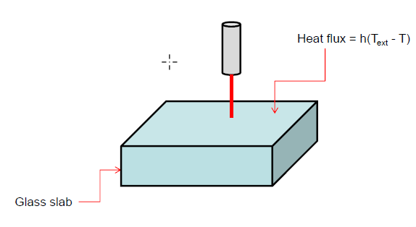
COMSOL Laser Heating Tutorial
2 types of simulations :
Laser with constant power
Laser with pulsed power

Slide 3
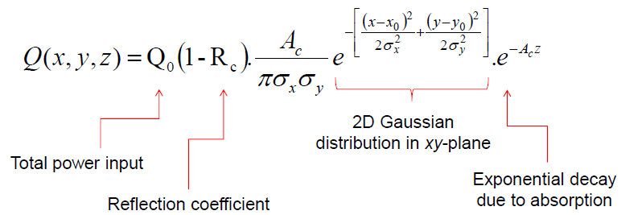
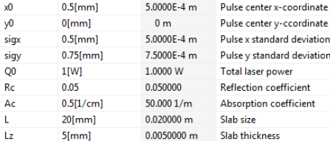
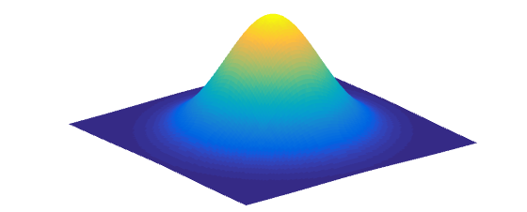
Laser with constant power: heat input on the surface and parameters
2D Gaussian heat input :
Parameters :

Slide 4
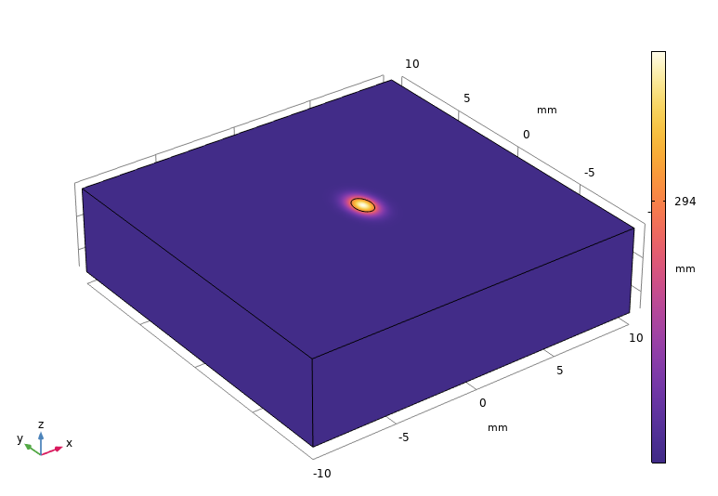
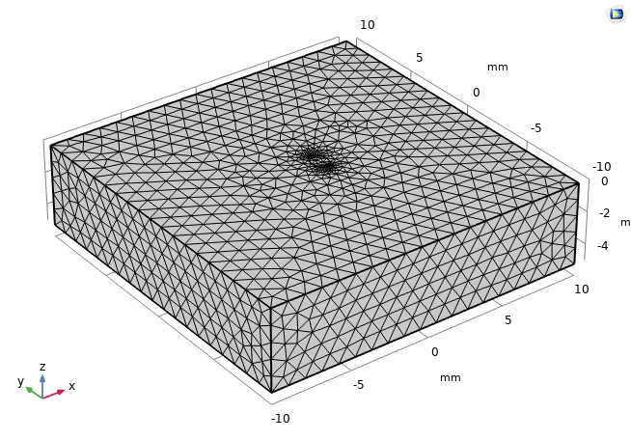
Laser with constant power: geometry

Slide 5
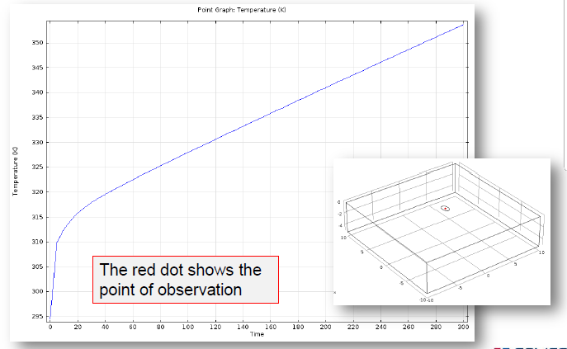
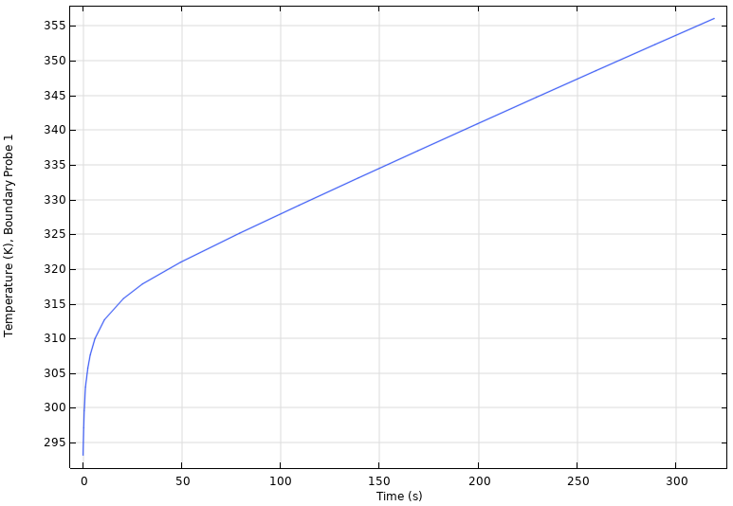
Laser with constant power: graph of the temperature evolution (at the center of the beam)
Expected results
Our simulation

Slide 6
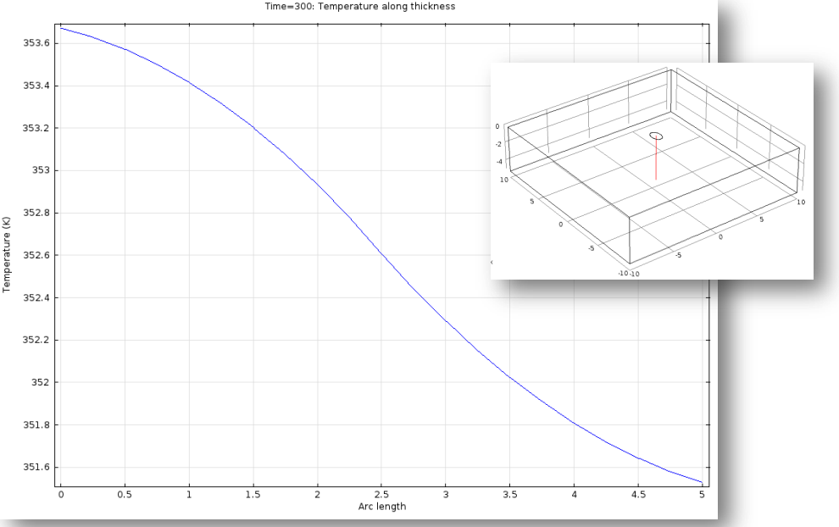
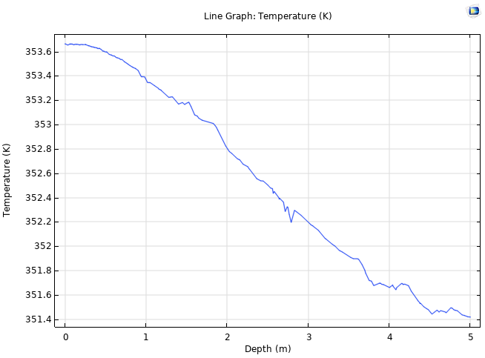
Laser with constant power: temperature vs depth
Expected results
Our simulation

Slide 7
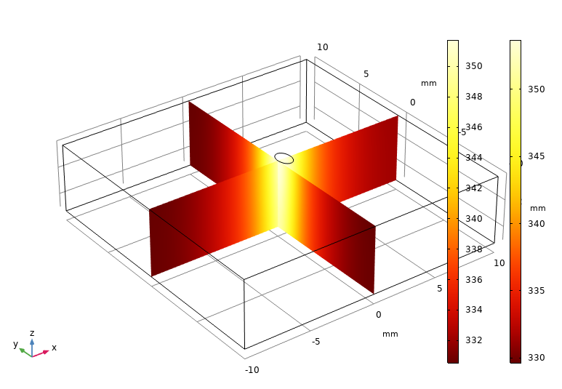
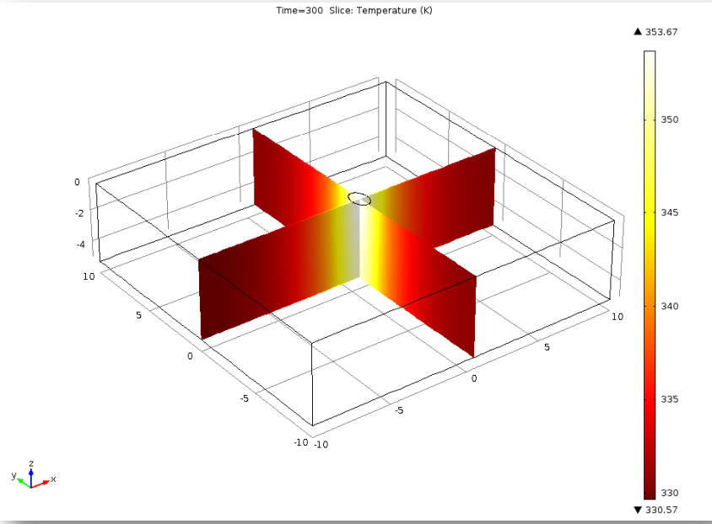
Laser with constant power: temperature profile slices (at the end of the simulation, 300s)
Expected profile
Our simulation

Slide 8
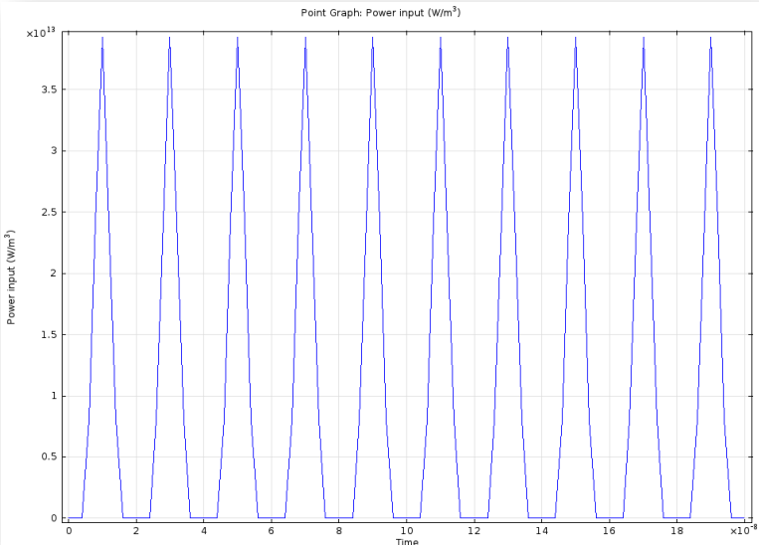
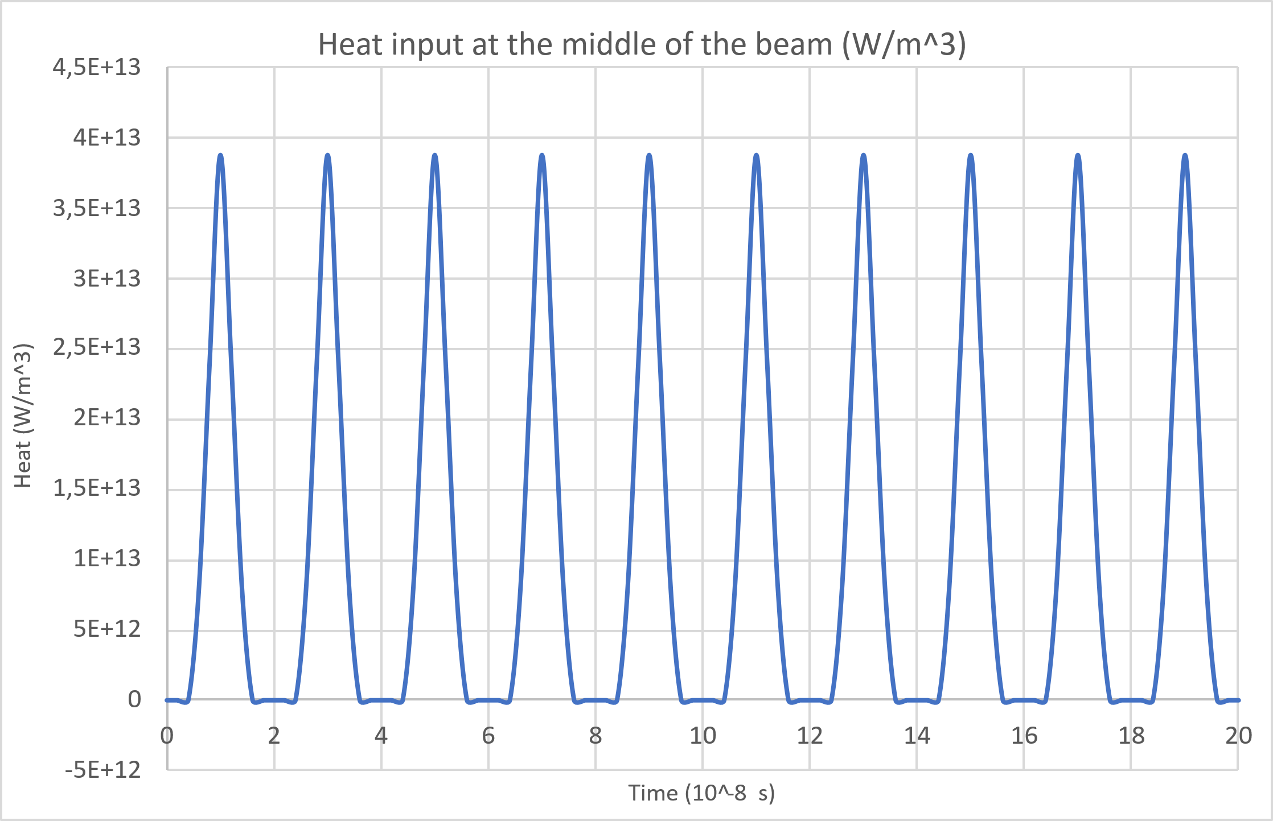
Laser with pulsed power: new parameters
Expected results
Our simulation
Pulse Duration: 10 ns
Number of pulse: 10
Total time: 200 ns

Slide 9
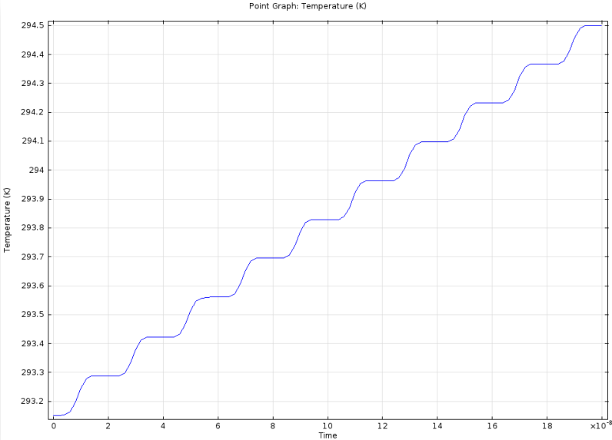
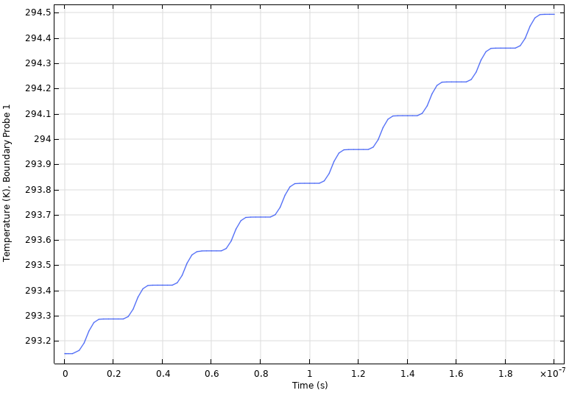
Laser with pulsed power: temperature evolution
Expected results
Our simulation

Slide 10
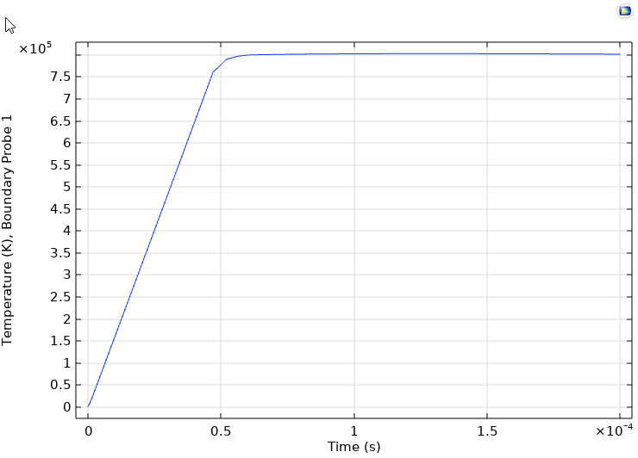
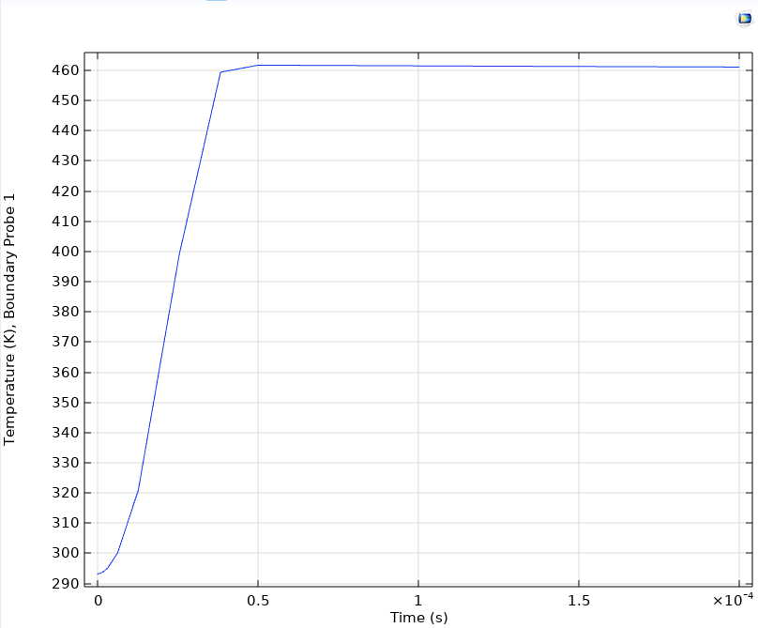
Application to TiN/GST layers: incorret values
TiN/GST layers
GLASS
Layers parameters:
Thickness of GST layer : 500 um
Thickness of TiN layer : 100um
TiN absorption coefficient : Ac=6.5*10^7 1/m
Glass absorption coefficient : Ac=50 1/m
Laser parameters:
Pulse duration: 50 us
Beam radius : 340 um
Laser maximal power : 880W

